Slide 1
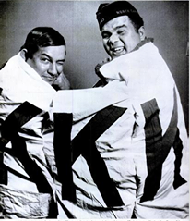
Look at the picture below. What details stand out to you? What do you think is going on?

Slide 2
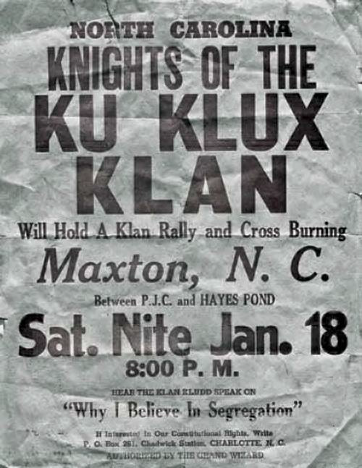

Slide 3
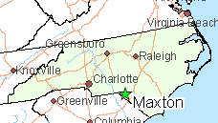
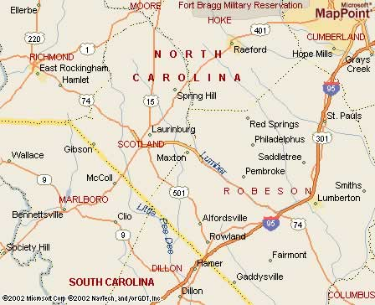

Slide 4
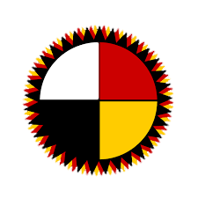
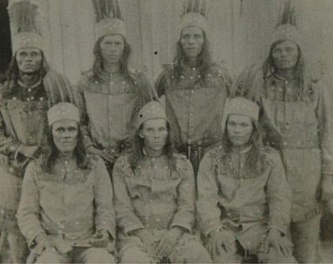
The Lumbee Tribe of NC
Descendants of the Cheraw tribe existed in/around Robeson County since 1700s
Takes name from Lumbee River
Recognized by North Carolina in 1885
A separate Indian School System was established, and in 1887, the state founded the Croatan Normal Indian School, which is today UNC-Pembroke
Petitioned for US recognition beginning in 1888
Lumbee Act passed in 1956, however, withheld full benefits of federal recognition.

Slide 5
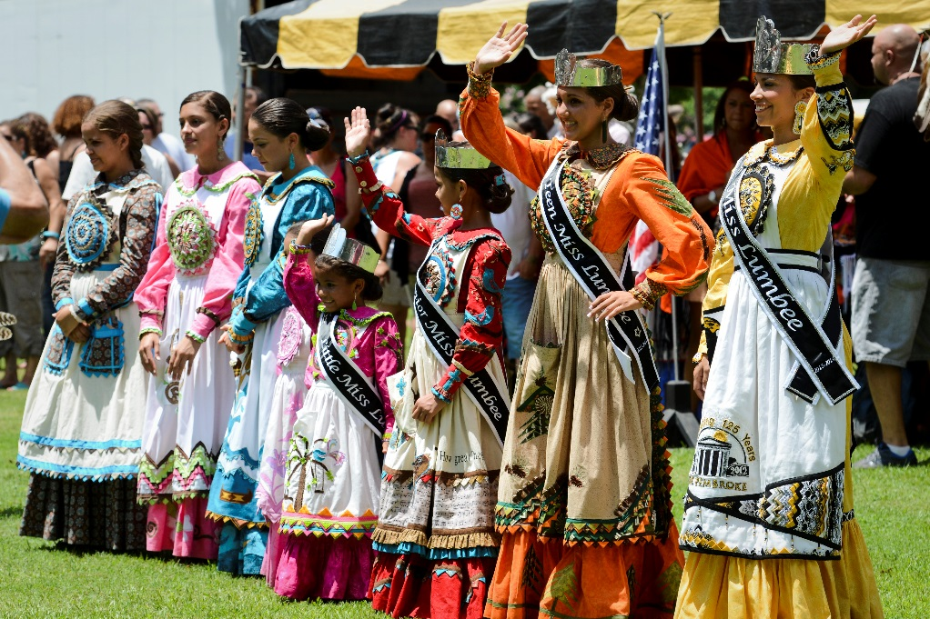
The Lumbee Tribe of NC
Largest tribe in North Carolina & east of Mississippi
9th largest tribe in the nation
Currently 40,000+ members, mostly in Robeson, Scotland, Hoke, & Cumberland County
Efforts still underway to seek full federal recognition

Slide 6
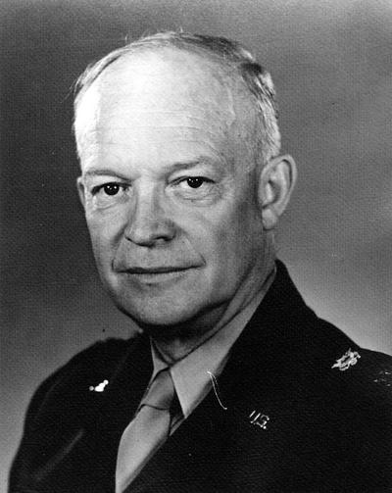
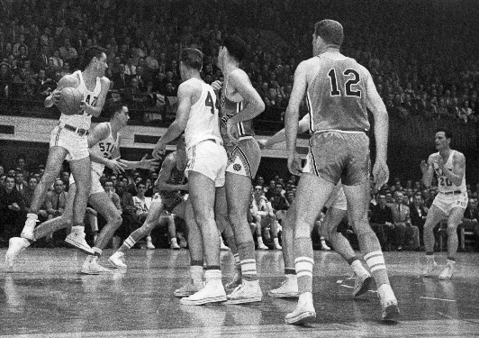
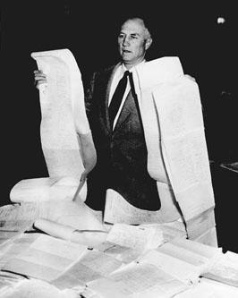
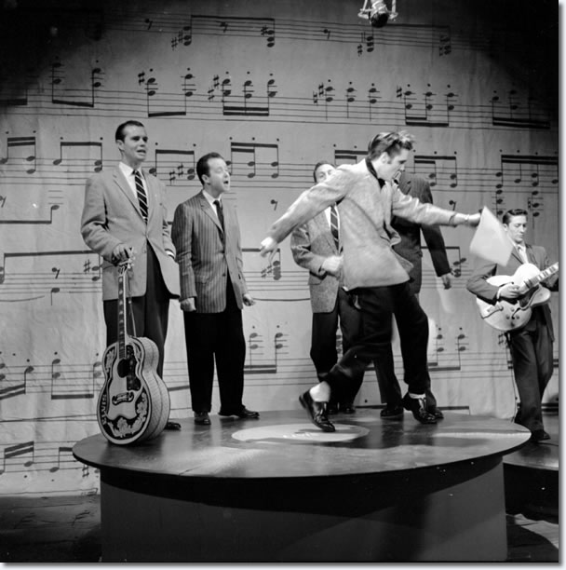
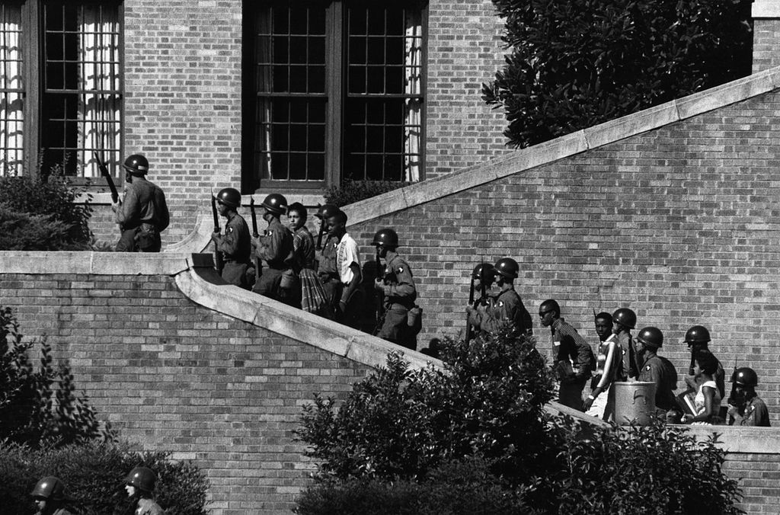
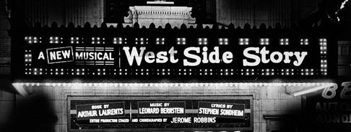
Let’s go back to 1957…
Strom Thurmond filibusters for 24 hrs against the Civil Rights Bill
Ike was president
UNC went undefeated
Little Rock Nine were admitted to Central High School
Elvis appeared on Ed Sullivan for the 3rd & Final Time
West Side Story & The Music Man debuted on Broadway

Slide 7
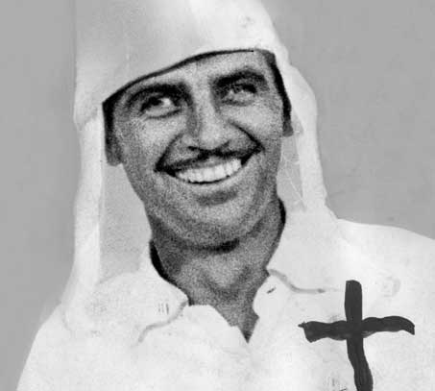
And in SC
Jim “Catfish” Cole was the Grand Wizard of the KKK

Slide 9
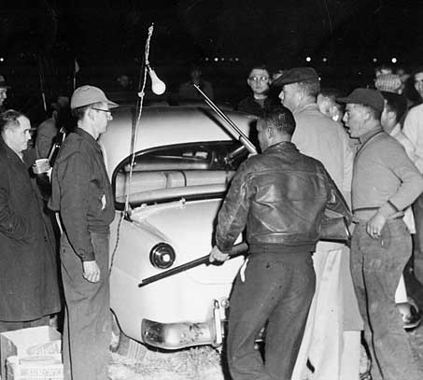
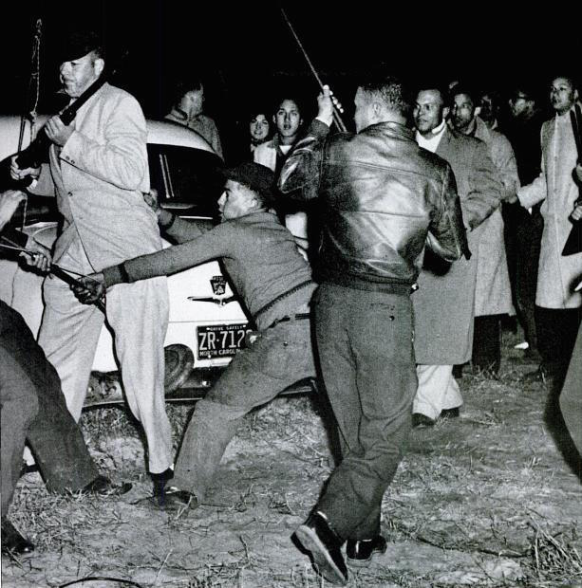

Slide 11
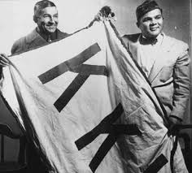

Slide 12
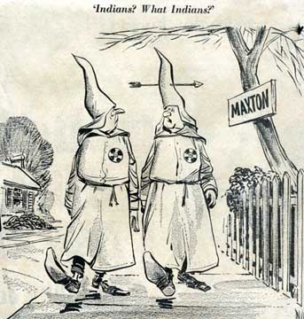

Slide 14
Oh have you seen the bedsheet boys
The terrors of the night
They rallied here at Maxton
Just honinʹ for a fight.
Oh, rally round, you Klansmen boys
But do not show your face.
Weʹll burn the fiery cross tonight
And save the Nordic race.
  CHORUS:
  Oh the Klan,
  Oh the Klan,
  It calls on evʹry red blood fighting man
  Who is free and white and bigot,
  Gets his courage from a spigot,
  They be needing reinforcements
  For the fight
  The Indians, the Indians,
They are our natural foe,
They lure our girls with coke and pie
And take them to the show,
They wear blue jeans and leather coats,
But anyone can see,
They are not real Americans
The like of you and me.

Slide 15
The headlights shone,
the Klansmen stood
In circle brave and fine,
When suddenly a whoop was heard
That curdled every spine,
An Indian youth with steely eyes,
He sauntered in alone,
He calmly drew his shootinʹ iron
And conked the microphone.
  CHORUS:
  Oh the Klan,
  Oh the Klan,
  It calls on evʹry red blood fighting man
  Who is free and white and bigot,
  Gets his courage from a spigot,
  They be needing reinforcements
  For the fight
  The Indians, the Indians,
Another shot, the lights went out,
There was a momentʹs hush,
Then a hundred thousand Lumbee boys
Came screaming from the brush.
Well, maybe not a million quite,
But surely more than four,
And the Klansmen shook from head to foot
And headed for the door.

Slide 16
The troopers they were down the road,
They did not lift a gun.
They heard the noise, they said, ʺThe boys
Are having a little fun.ʺ
But when they saw the nightshirt lads
Trooping down the road,
They knew that something went amiss,
The wrong switch had been throwed.
One lonely Klansman in the brush
The troopers chance to find
He ran away and left me here behind
He staggered home that greenish morn to greet his loving wife
She beat him with a rolling pin for losing her kitchen knife
  CHORUS:
  Oh the Klan,
  Oh the Klan,
  It calls on evʹry red blood fighting man
  Who is free and white and bigot,
  Gets his courage from a spigot,
  They be needing reinforcements
  For the fight
  The Indians, the Indians,

