Slide 1
Colonist & American Indian Conflicts

Slide 2
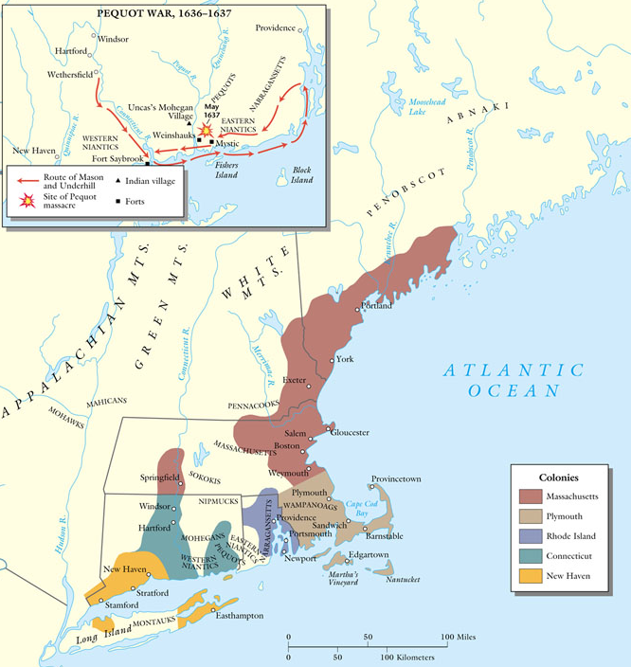
The Pequot Wars: 1636-1637
Pequots: powerful tribe in CT river valley
Controlled fur trade in region
Whites, with Narragansett Indian allies, attacked Pequot village on Mystic River.
Whites set fire to homes & shot fleeing survivors
Pequot tribe is virtually annihilated

Slide 3
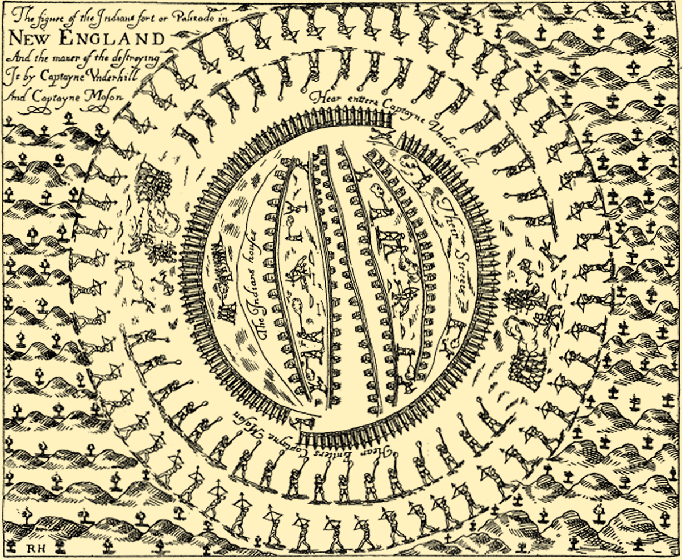
A Pequot Village Destroyed, 1637

Slide 4
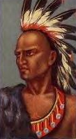
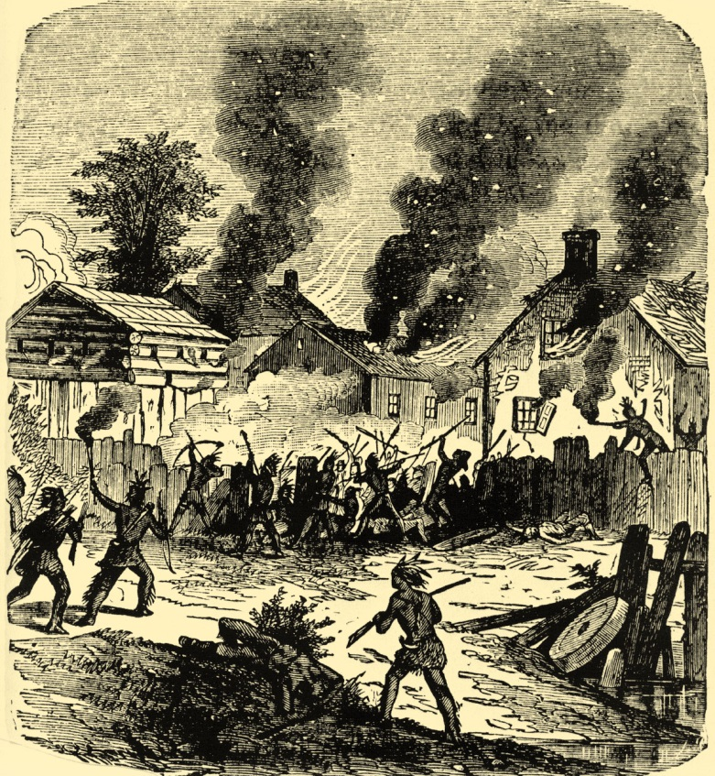
King Philip’s War (1675-1676)
Metacom (King Philip to white settlers)
Wanted to unite different nations
Staged coordinated attacks on white settlements throughout New England.
Frontier settlements forced to retreat to Boston.

Slide 5
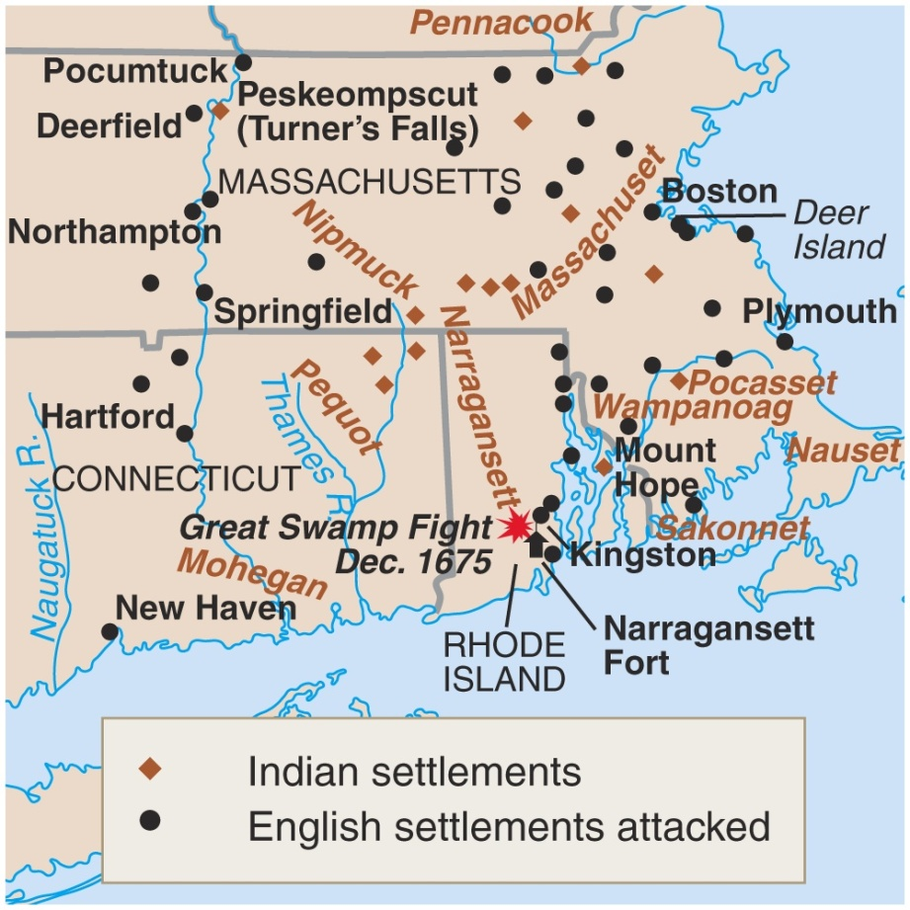
King Philip’s War (1675-1676)
The war ended in failure for the Indians
Metacom beheaded and drawn and quartered.
His son and wife sold into slavery.
Never again a serious threat in New England

Slide 6
King Philip’s War

Slide 7
The Great Awakening

Slide 8
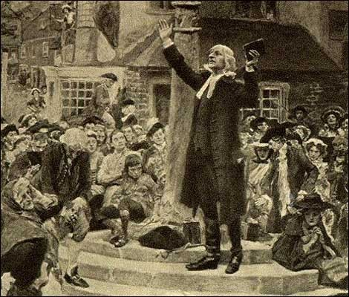
The Great Awakening (1720-1760)
Evangelical Protestant Movement
Colonists lost the religious passion
Religion had become dry and dull, passionless
Religious revival lead by travelling ministers
inner religious belief was more that outward behavior
Appealed to the heart and drew large crowds

Slide 9
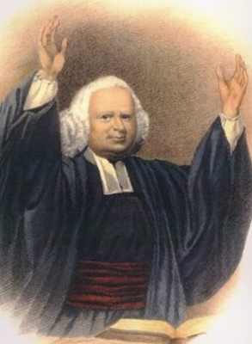
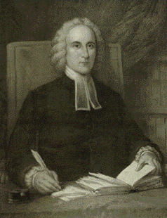
Leaders of the Movement
George Whitefield
Jonathan Edwards

Slide 10
New Lights vs. Old Lights
New Lights
Old Lights
Part of the new “revivals”
Felt that religious message had run astray.
Baptists, Methodists, and Presbyterians
Traditional “old” beliefs within the colonies.
Congregationalists
Quakers
Anglicans

Slide 11
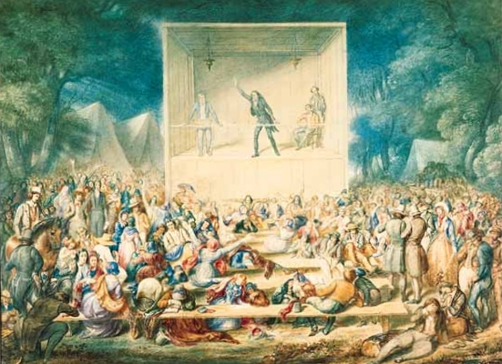

Slide 12
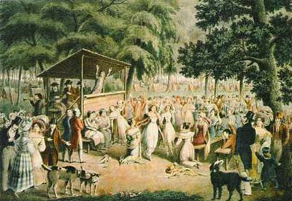

Slide 13
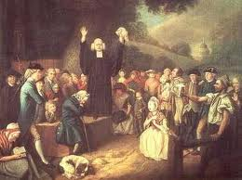

Slide 14
“Sinners in the Hands of an Angry God,” Jonathan Edwards (1741)
“O sinner! Consider the fearful danger you are in: it is a great furnace of wrath, a wide and bottomless pit, full of the fire of wrath, that you are held over in the hand of that God, whose wrath is provoked and incensed as much against you, as against many of the damned in hell. You hang by a slender thread, with the flames of divine wrath flashing about it, and ready every moment to singe it, and burn it asunder; and you have . . . nothing to lay hold of to save yourself, nothing to keep off the flames of wrath, nothing of your own, nothing that you ever have done, nothing that you can do, to induce God to spare you one moment.”
“. . . All you that never passed under a great change of heart, by the mighty power of the Spirit of God upon your souls; all you that were never born again . . . are in the hands of an angry God . . .”

Slide 15
Ben on George Whitefield
“I happened soon after to attend one of his sermons, in the course of which I perceived he intended to finish with a collection, and I silently resolved he should get nothing from me. I had in my pocket a handful of copper money, three or four silver dollars and five . . . gold [coins]. As he proceeded I began to soften, and concluded to give the coppers. Another stroke of his oratory made me ashamed of that, and determined me to give the silver; and he finished so admirably, that I empty'd my pocket wholly into the collector's dish, gold and all.”
Benjamin Franklin, 1742

Slide 16
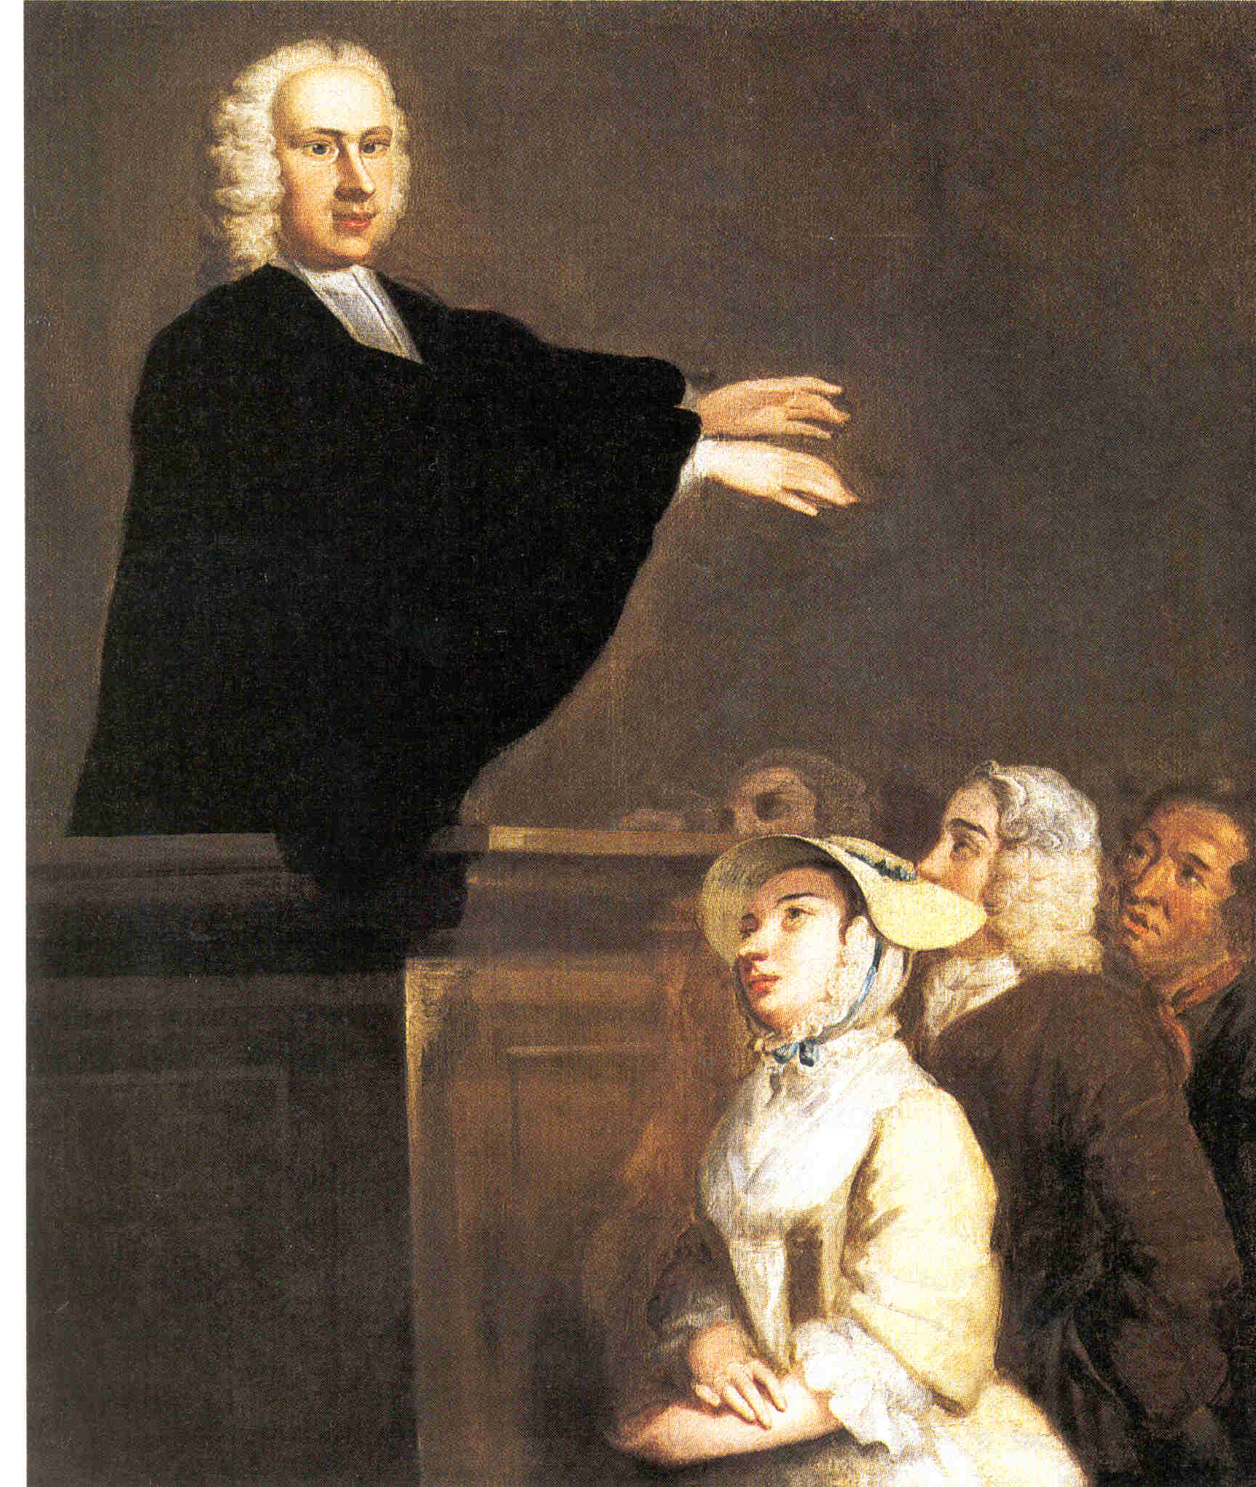
Impact of the Great Awakening
1st shared experience in colonies
an American culture
Friction between new and old religious groups
New ministers, new colleges (Princeton, Brown, Rutgers, Columbia, etc.)
Appeal to African and Native Americans
More Religious toleration

Slide 17
Seven Year’s War & Great Awakening

