Slide 1
Counterculture and the 1960s

Slide 2
Women
What are they Against?
What are they For?
The objectification of women.
Limited career opportunities.
The criminalization of abortion.
Women’s liberation” - Equal opportunity.
Abortion rights.
Affirmative action policies.
The formal title of Ms.

Slide 3
Women
Key People
Tactics They Used/Events
Betty Friedan - wrote The Feminine Mystique inspiring the movement
Gloria Steinem founded NOW – the National Organization for Women and Ms. Magazine
Phyllis Schlafly – key OPPONENT to the Equal Rights Amendment, which failed to pass
Roe v. Wade – guaranteed women to a legal, safe abortion within certain time limits.

Slide 4
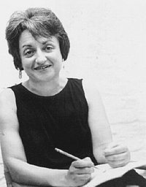
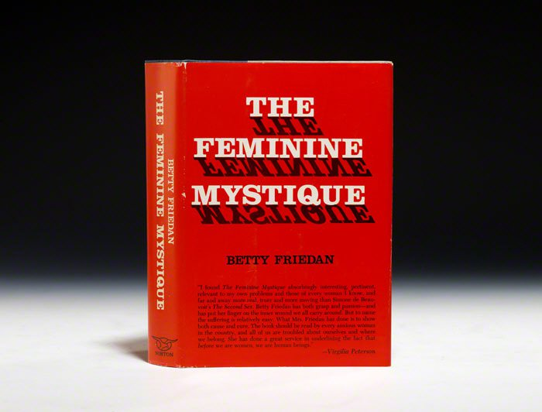
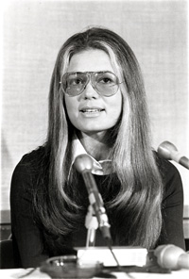
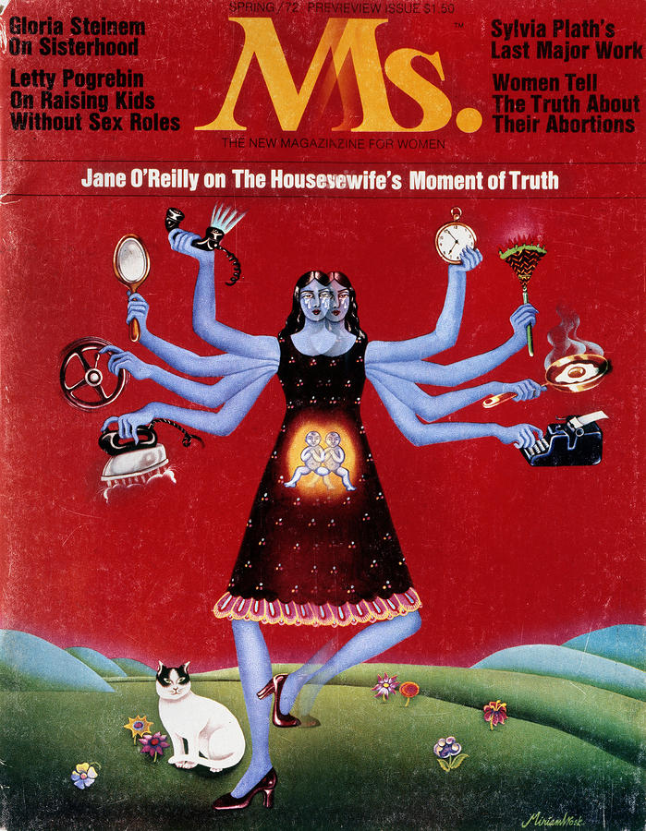
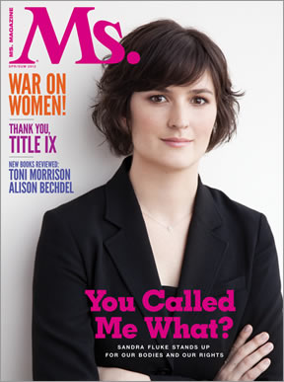

Slide 5
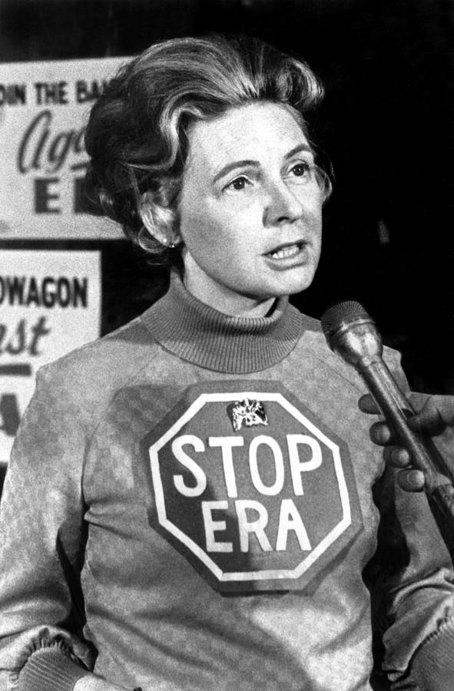

Slide 6
Native Americans
What are they Against?
What are they For?
Broken treaties
The Termination Policy of the 1950s that broke up tribes and tried to assimilate natives into cities
The corruption of the Bureau of Indian Affairs
Poverty / alcoholism / resource extraction on land
Self determination and tribal autonomy
Restoration of tribal lands as had been established under the New Deal / Indian Reorganization Act.

Slide 7
Native Americans
Key People
Tactics They Used/Events
Dennis Banks
Coordinated with the Black Panthers.
Takeover of Alcatraz Island from 1969-1971.
Dept. of Interior Bureau of Indian Affairs building takeover
71-day armed standoff with federal forces at Wounded Knee, South Dakota
Passage of the Indian Civil Rights Act of 1968, restoring tribal life.

Slide 8
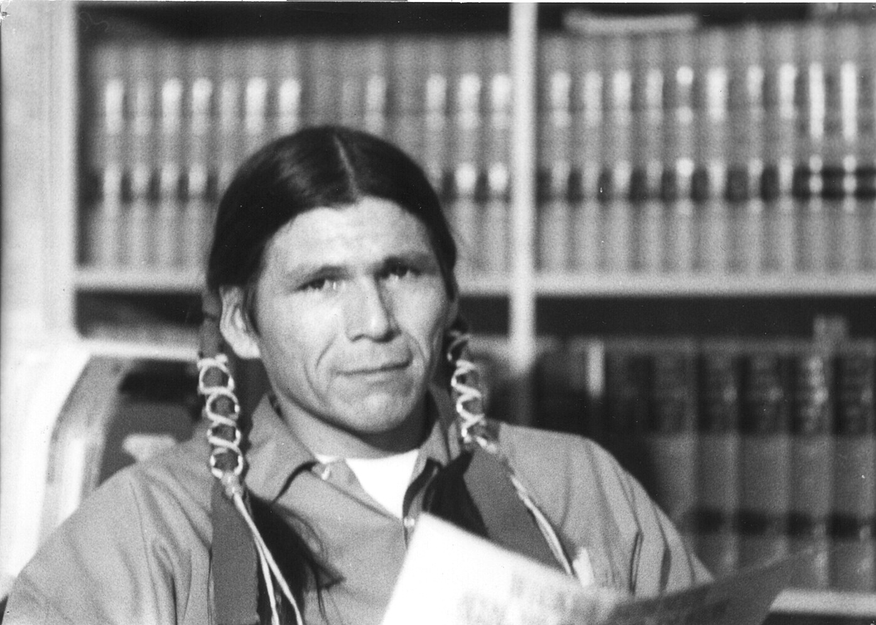
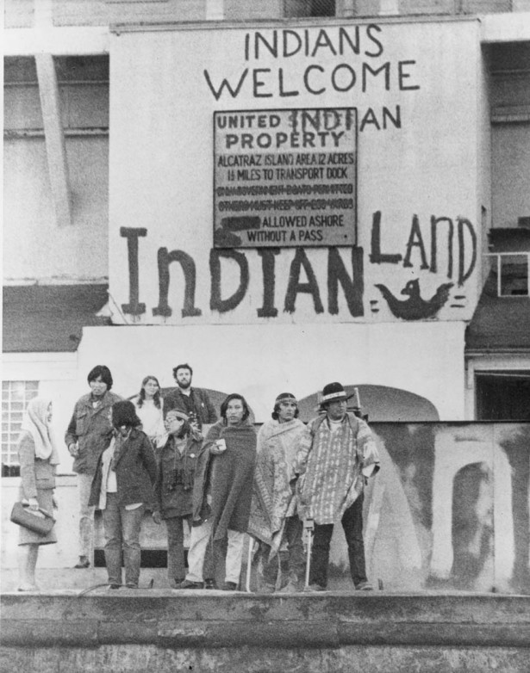
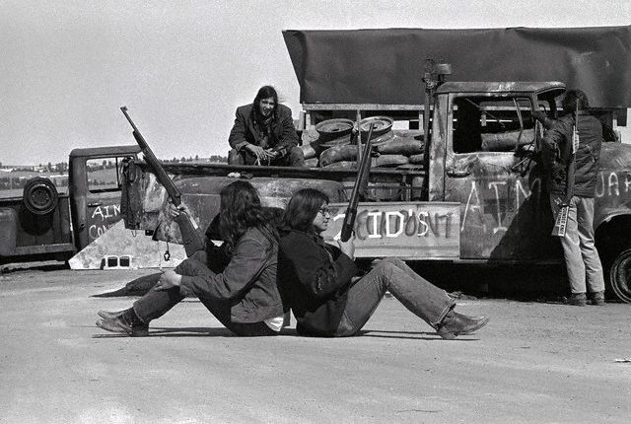

Slide 9
Latinos
What are they Against?
What are they For?
Poverty / hunger
Low wages
Dangerous working conditions
Lack of access to public services / education
Unionization of farm labor
Bilingual ballots / education access
Public services for migrants / undocumented workers

Slide 10
Latinos
Key People
Tactics They Used/Events
Cesar Chavez – founded the United Farm Workers
Boycott of the grape industry to force negotiations
established a broad base of local Community Service chapters
Led to the establishment of a political branch called La Raza that supported Latino candidates for political office.

Slide 11
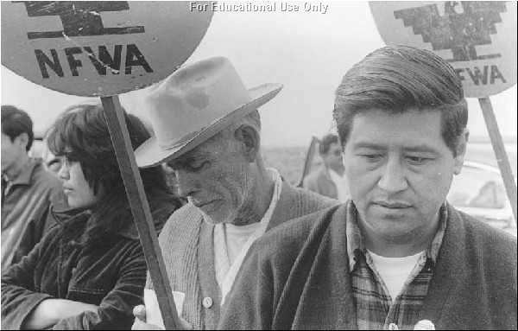
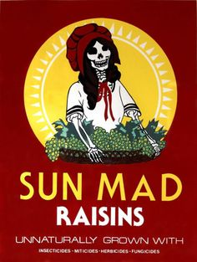

Slide 12
Hippies
What are they Against?
What are they For?
The Vietnam War
Materialism/ consumerism
Conventional thinking/conformity
Sexual liberation
Experimentation with mind altering substances
Random acts of exuberance
Rock n’ roll music
Draft Dodging

Slide 13
Hippies
Key People
Tactics They Used/Events
Timothy Leary – Harvard Psychology professor who advised people to “Tune in, Turn On, and Drop Out,” invents LSD
Haight Ashbury – most famous Hippie neighborhood, in San Francisco
Woodstock – 1969 – largest impromptu outdoor music festival
Protests

Slide 14
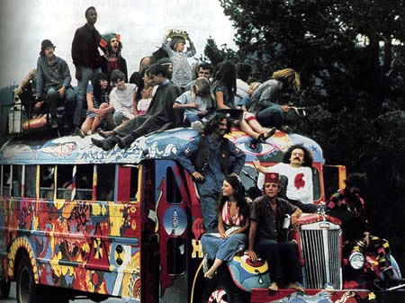
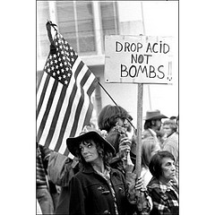
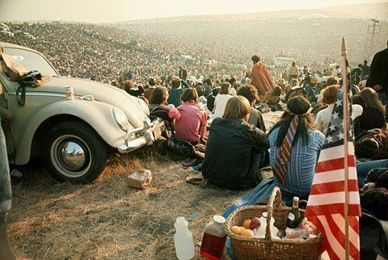
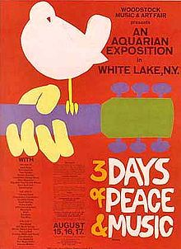

Slide 15
Counterculture / Chaos
FSM – 1 of 3 – 6:15-8:17
Counterculture – 3 of 3 – 7:50, 37:50
Chaos / convention – 3 of 3 – 9:28, 39:28

