Slide 1
Gilded Age Documents

Slide 2
Document A: New Immigrants
From 1880 to 1921, a record setting 23 million immigrants arrived in the USA. At the time, the USA did not have quotas, or limits, on how many immigrants from a particular country could enter the country. Nor did it require immigrants to have a passport or special entrance papers.
Where immigrants were coming from changed dramatically. From the colonial era to 1880, most immigrants to America came from England, Ireland, or Germany in Northern Europe. Between 1880 and 1921, approximately 70% of all immigrants entering the USA came from southern and eastern Europe (Italy, Austria-Hungary, Russia, Poland).
These “new immigrants” were typically young, male, and either Catholic or Jewish. Most spoke little or no English. The majority were unskilled agricultural laborers with little money or education.

Slide 3
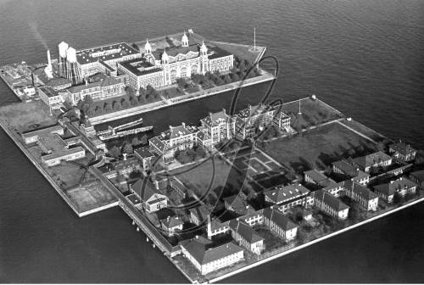
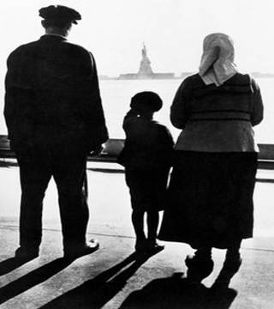
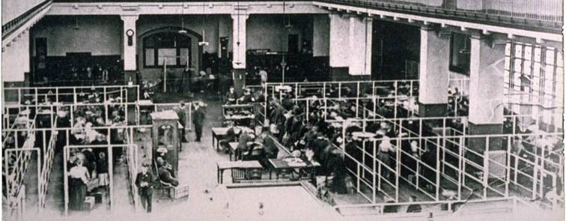

Slide 4
Document B: Ellis Island
From 1892 to the early 1920s, around 75% of all immigrants entered the USA through the immigration processing center at Ellis Island, located in New York Harbor.
The processing of immigrants on Ellis Island was an ordeal that might take five hours or more. First, they had to pass a physical examination by a doctor. Anyone with a serious health problem or a contagious disease, such as tuberculosis, was promptly sent home.
Those who passed the medical exam then reported to a government inspector. The inspector questioned immigrants to determine whether they met the legal requirements for entering the USA. The requirements included proving they had never been convicted of a felony, demonstrating that they were able to work, and showing that they had some money (at least $25 after 1909).

Slide 5
Document C: Urban Housing
Most cities weren’t prepared for such increasing populations. City streets were often flooded with waste due to inadequate sewage systems. Decent housing was scarce, most urban-dwelling immigrants lived in tenement buildings – rundown, low rent apartment buildings clustered together in the poorest parts of town.
Most tenements were filthy, run down and had little ventilation or light. Fires, disease and death were common among immigrant tenement communities. Half of Manhattan’s fires were in tenement buildings.
Many immigrants came down with contagious lung disease, tuberculosis, and about 60% of immigrant babies died before their first birthday.

Slide 6
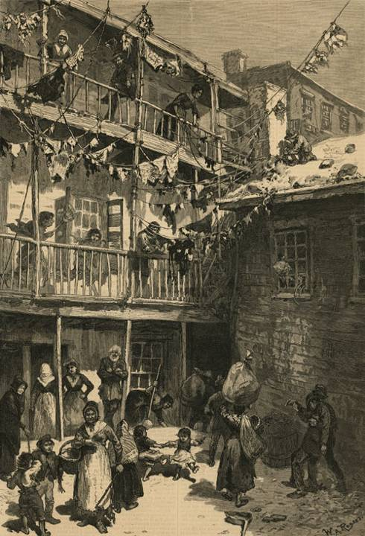
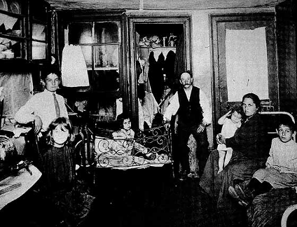
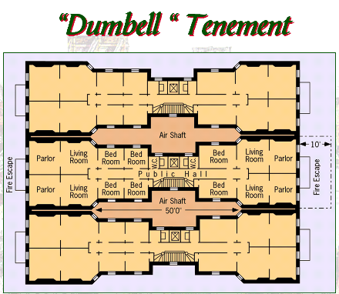

Slide 7
Document D: Nativism
Many native-born Americans viewed the new immigrants with a combination of fear, hostility and suspicion. Nativism was based on the belief that immigrants posed a threat to native-born Americans and their way of life. Nativists had deep-seated prejudices about immigrants based on ethnicity, religion, political and social beliefs.
Many American workers accused immigrants of taking jobs away from “real” Americans. Nativists worked to restrict the number of immigrants entering the United States.
In 1883, Congress passed the Chinese Exclusion Act which restricted Chinese immigration to America. In the 1890s, they called for laws restricting the number of new immigrants from Southern and Eastern Europe. They encouraged quotas that would limit the number of immigrants the US would accept from each nation.

Slide 8
Document E: Working Conditions
The majority of immigrants worked in industrial jobs, for a variety of reasons. Most industries were rapidly growing and in need of workers. Most immigrants were unskilled laborers, were desperate for work, and were willing to accept almost any kind of job, no matter how un-attractive or low paying.
Immigrants were particularly vulnerable to exploitation and many worked under intolerable conditions. The average worker’s salary was about 10 cents an hour and child workers often made half that. Additionally, many workers were forced to work 12-16 hours per day.
Working conditions were often dangerous, unsanitary and uncomfortable.

Slide 9
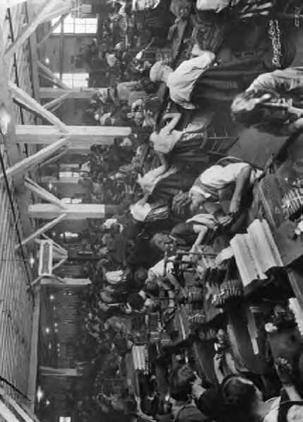
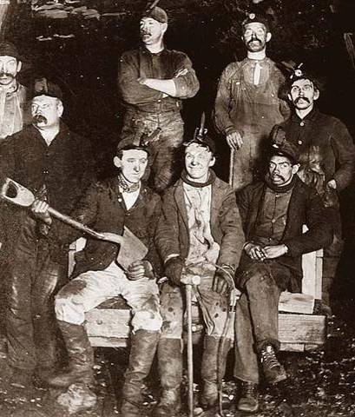

Slide 10
Document F: Child Labor
Because their poor families needed them and businesses welcomed them, around 1.75 million children joined the work force in the late 1800s.
These laborers were mostly between the ages of 10-15, but some were as young as 6. Children worked up to 15 hours a day in coal mines and factories.
Child labor was especially common in mining because their small size worked well in the cramped spaces. Common injuries in the mines included back deformities, asthma and crushed or broken fingers. Many other industries employed and similarly harmed children.

Slide 11
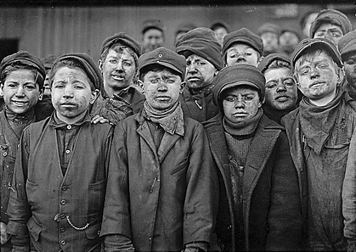
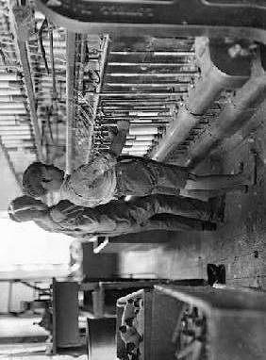
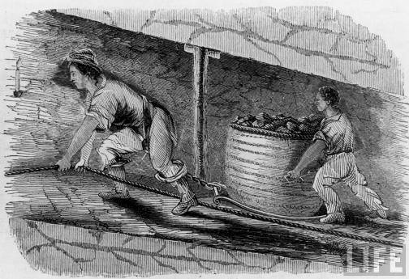

Slide 12
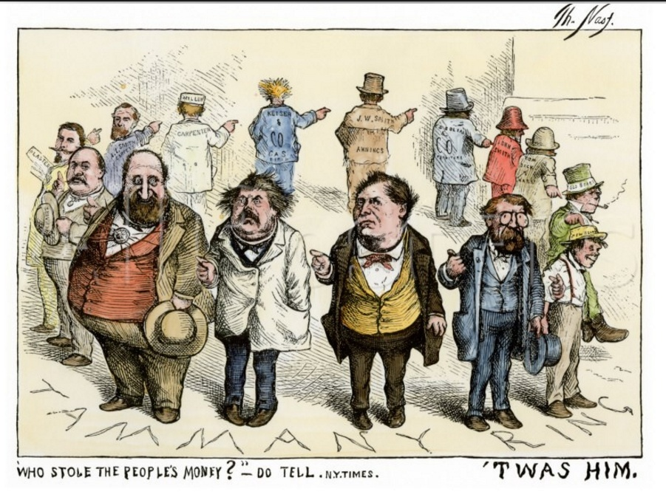
Document G

Slide 13
Document H: Hamlin Garland visited Homestead, Pennsylvania, and the Carnegie steel mills to write this article for McClure’s Magazine.
. . .The streets of the town were horrible; the buildings were poor; the sidewalks were sunken, swaying, and full of holes, and the crossings were sharp-edged stones set like rocks in a river bed. Everywhere the yellow mud of the street lay kneaded into a sticky mass, through which groups of pale, lean men slouched in faded garments, grimy with the soot and grease of the mills.
This town was as squalid [dirty] and unlovely as could well be imagined, and the people were mainly of the discouraged and sullen type to be found everywhere where labor passes into the brutalizing stage of severity. It had the disorganized and incoherent effects of a town which has feeble public spirit. Big industries at differing eras have produced squads [groups] of squalid
tenement-houses far from the central portion of the town, each plant bringing its gangs of foreign laborers in raw masses to camp down like an army around its shops. Such towns are sown thickly over the hill-lands of Pennsylvania, but this was my first descent into one of them. They are American only in the sense in which they represent the American idea of
business. . . .
Source: Hamlin Garland, “Homestead and Its Perilous Trades–Impressions of a Visit,” McClure’s Magazine, June, 1894

Slide 14
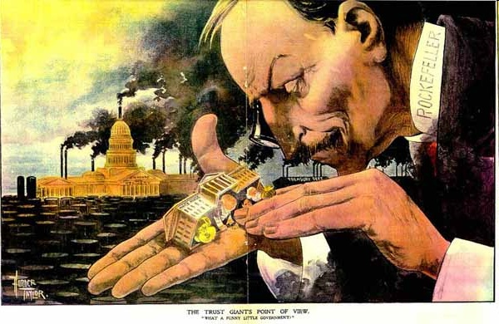
Document I: THE TRUST GIANT’S POINT OF VIEW, “What a Funny Little Government”

Slide 15
Document J: Although they sometimes used controversial methods to accumulate wealth, many industrialists, such as Andrew Carnegie, John D. Rockefeller, and J. P. Morgan, also gave away millions of dollars. This excerpt describes some of the charitable work of Andrew Carnegie
. . . But despite his wealth-getting, his wage-cutting, and his responsibility for a bloody labor dispute at his Homestead plant in 1892, Carnegie had not forgotten his heritage of concern for social justice. In his 1889 article “Wealth,” he gloried in the cheap steel his leadership had given the American consumer but also proclaimed the moral duty of all possessors of great wealth to
plow back their money into philanthropy [charity] with the same judgment, zeal, and leadership they had devoted to getting rich. And he lived up to that precept [principle], paying for thousands of library buildings, setting up trusts and foundations, endowing universities, building Carnegie Hall in New York and the Peace Palace at The Hague, and much more. He once wrote that the man who dies rich dies disgraced. He had some sins to answer for, and it took him a while, but in 1919 at eighty-three Andrew Carnegie died in a state of grace by his own agnostic
[non-religious] definition. . . .

Slide 16
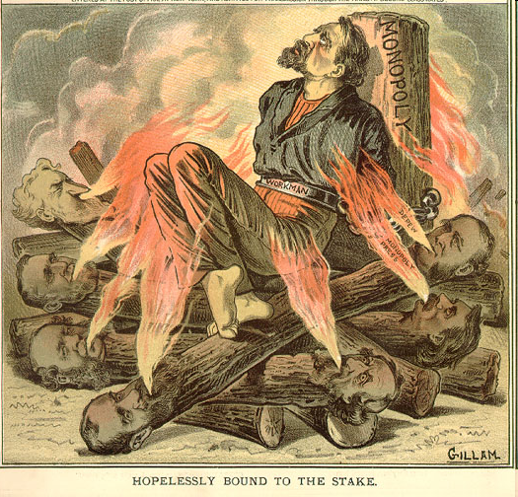
Document K

Slide 17
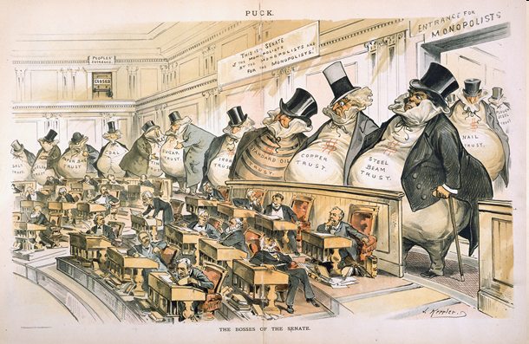
Document L

Slide 18
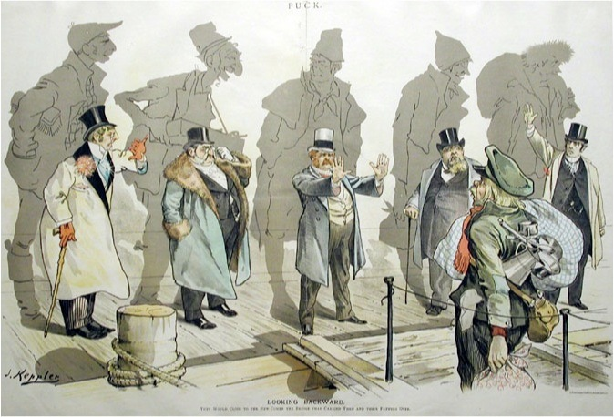
Document M: Looking Backward

Slide 19
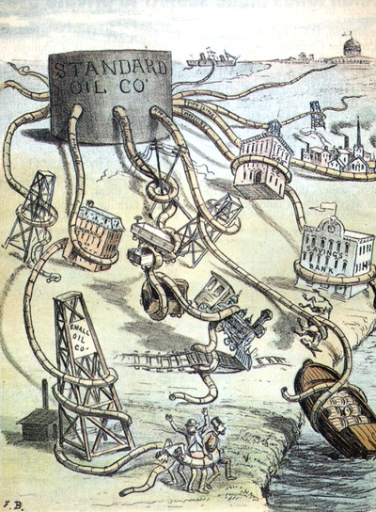
Document N: Standard Oil Octopus

