Slide 1
The Nitty-Gritty
Ins and Outs of War and battle

Slide 3
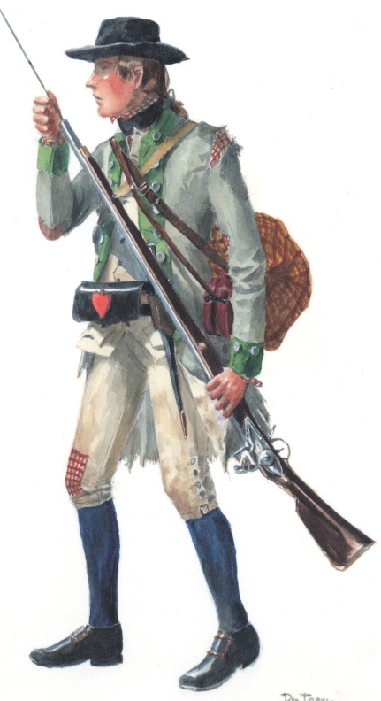
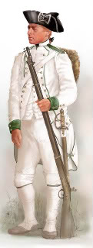
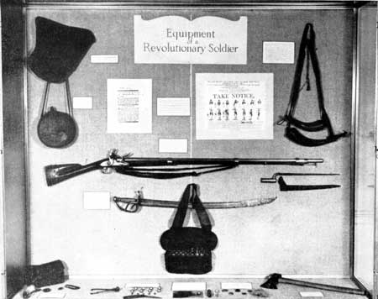
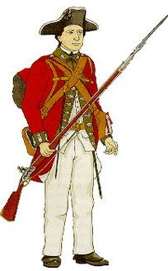
At any given time, a Revolutionary soldier was probably marching with 45-60 lbs of equipment!

Slide 4
Battle Strategy

Slide 5
Who Should Win?
British | Americans
British government strongest in world | American government did not yet exist
lots of money | no money
army strongest in the world | American army made up of citizen-soldiers who were badly trained
many officers | few officers with any experience France helped by sending money and trained officers
British navy ruled the seas | No navy
fighting 3000 miles away form home - had to ship men and supplies | fighting at home - English might lose because couldn't get soldiers over quickly
fight was over a large area | Many people willing to help patriot soldiers
British army had trouble getting soldiers because many people had family members and friends in America.

Slide 6
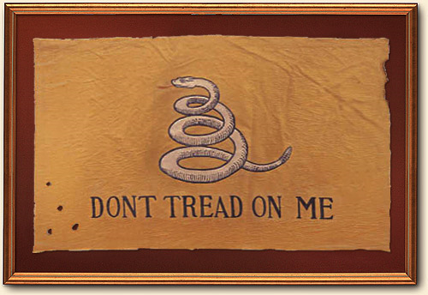
But maybe most important…
Americans are fighting for a cause

Slide 7
The Strategy of War
American
Keep the Colonial Army together
Stretch the British army away from supply lines
Harass the enemy, defeat the British in a major battle—guerrilla warfare
Get allies to help win
Britain
Seeks to destroy the Colonial Army
Regain control of the colonies by region
Take the fight to the Colonial Army using European war tactics
Use loyalists support against the colonies

Slide 8
The Strategy of War

Slide 9
Battle of Quebec
Dec 31, 1775
Americans want to take Canada from British control
Attack led by Montgomery, Morgan, and Arnold
GB crushes colonies, first major loss
America gives up hope of invading Canada

Slide 10
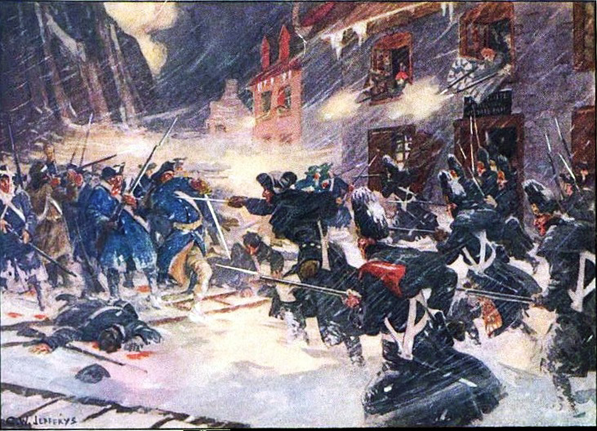

Slide 11
Crossing the Delaware & Battle of Trenton
Dec 26, 1776
Surprise attack led by George Washington on combo of British and Hessian troops
Successful attack, 900 British are killed/captured
America regains control of New Jersey, much needed victory

Slide 12
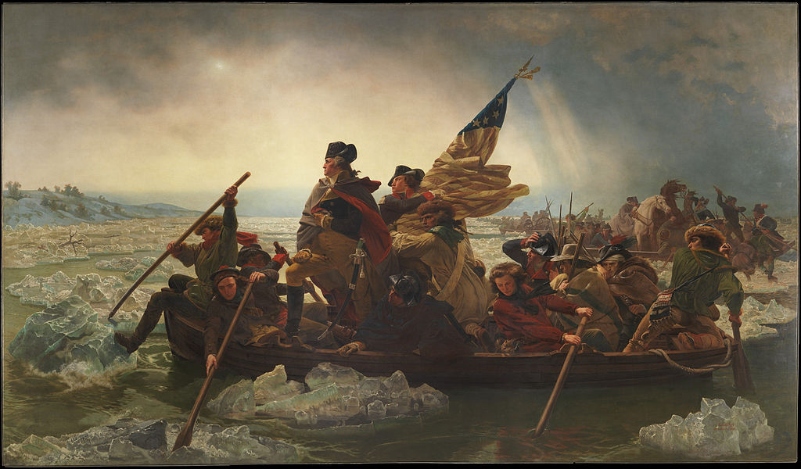

Slide 13
Battle of Saratoga
Sept-Oct 1777
Gates v. Burgoyne
Colonists use guerilla warfare to weaken GB troops
GB surrenders to Gen Gates
France convinced to join on America’s side
Benedict Arnold will eventually become a traitor to US after Saratoga

Slide 14
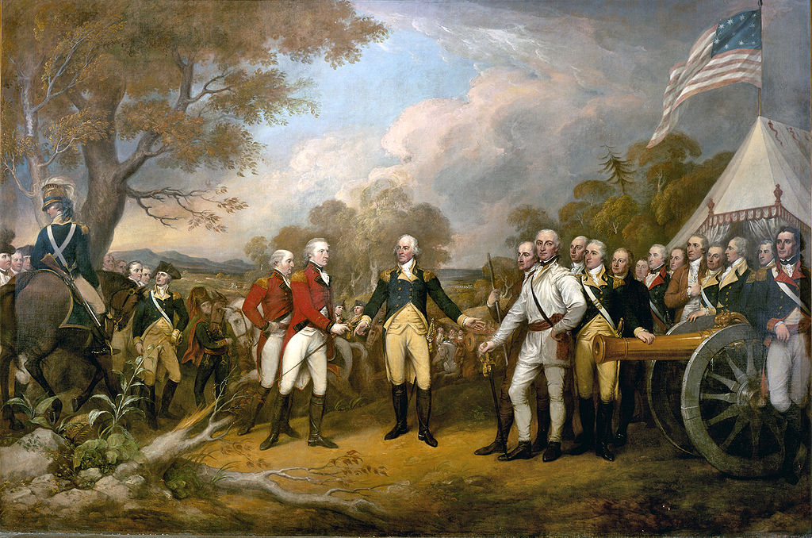

Slide 15
Winter at Valley Forge
Winter 1777-1778
Washington’s men camp for winter
Low on supplies, harsh conditions, disease rampant, morale low
Prussian von Steuben will eventually come to train men, brings experience to army
"These are the times that try men's souls." -Thomas Paine

Slide 16
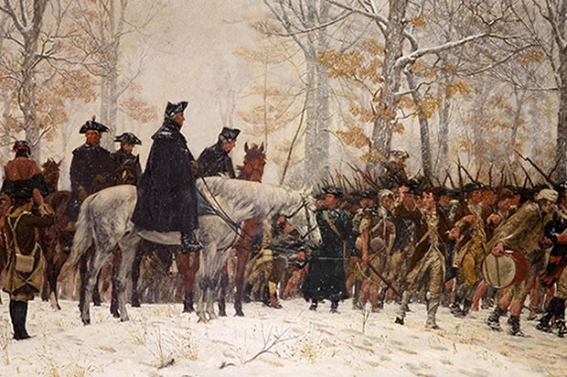

Slide 17
Battle of the Bonhomme Richard
Sep 23, 1779
Naval battle off coast of England
John Paul Jones leads attack on 2 English ships
3 hour battle, the Bonhomme Richard sinks, but Jones successfully captures the Serapis
Most significant naval battle of war
“I have just begun to fight.” -Jones

Slide 18
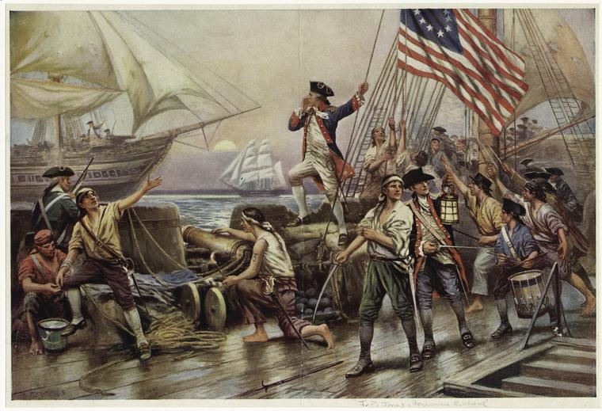

Slide 19
Battle of Camden
Aug 16, 1780
Major battle fought in the South
Gates v. Lord Cornwallis
Militia retreats, many are killed
Defeat of Americans, GB maintains control of South Carolina
Cornwallis tries to push up and control South

Slide 20
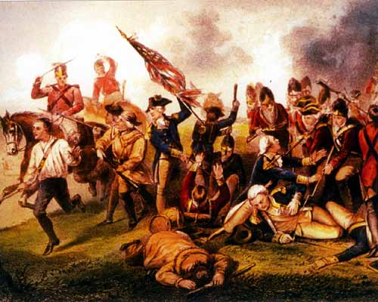

Slide 21
Battle of Guilford Courthouse
March 15, 1781
Greene v. Cornwallis
America tries to keep hold of South
Militia and Continental Army meet Cornwallis in NC
GB technically wins, but loses many men
“Another such victory will lose us the war.” —Cornwallis
Stops British hopes of gaining the Carolinas, Cornwallis retreats and camps out at Yorktown

Slide 22
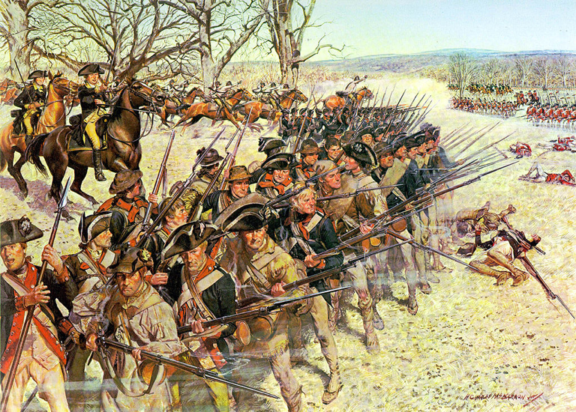

Slide 23
Turning Point Battles
Quebec: America gives up hope of invading Canada
Trenton: America regains control of New Jersey, much needed victory
Saratoga: France convinced to join on America’s side
Valley Forge: harsh winter, training from von Steuben
Bonhomme Richard: John Paul Jones, Most significant naval battle of war
Camden: Cornwallis tries to push up and control South
Guilford Courthouse: Stops British hopes of gaining the Carolinas, Cornwallis retreats and camps out at Yorktown

