Slide 1
Vietnam War

Slide 2
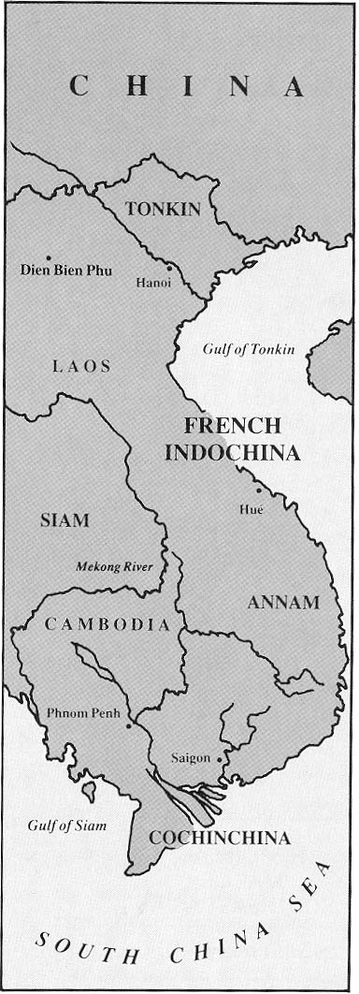
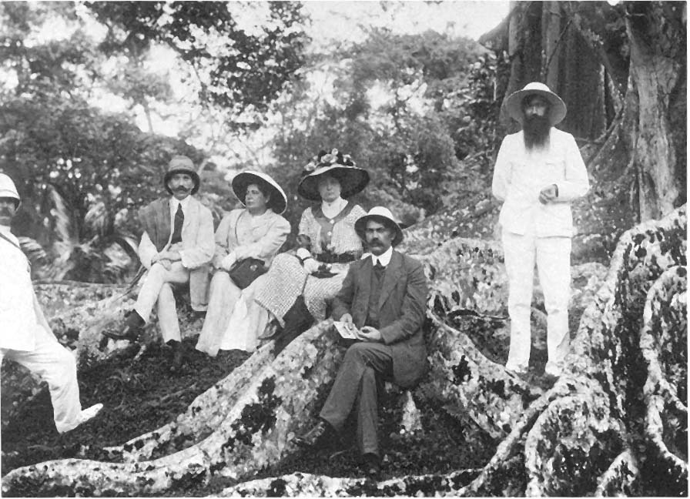
French Colonization
1800s-WWII—France controls Indochina (Vietnam, Laos, and Cambodia); Restricts Vietnamese rights

Slide 3
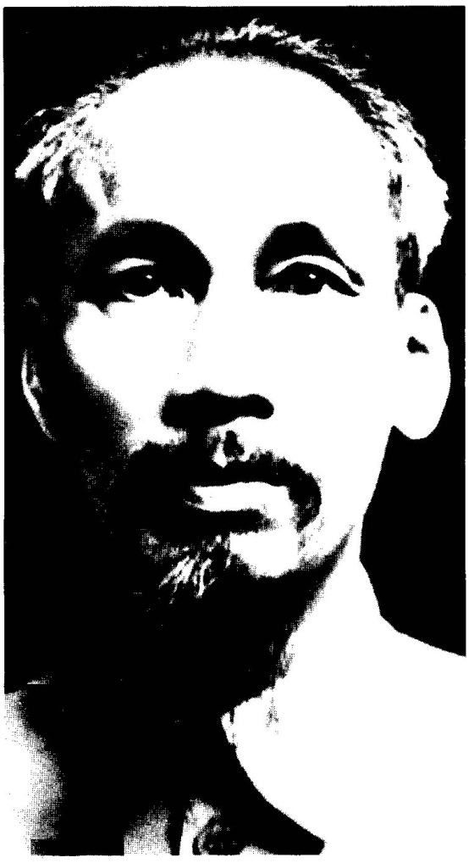
Ho Chi Minh
Ho Chi Minh led a group opposed to French rule.
sought independence
founds Indochinese Communist Party
Vietminh
Ho’s followers
Declared Northern independence in Hanoi in 1945

Slide 4
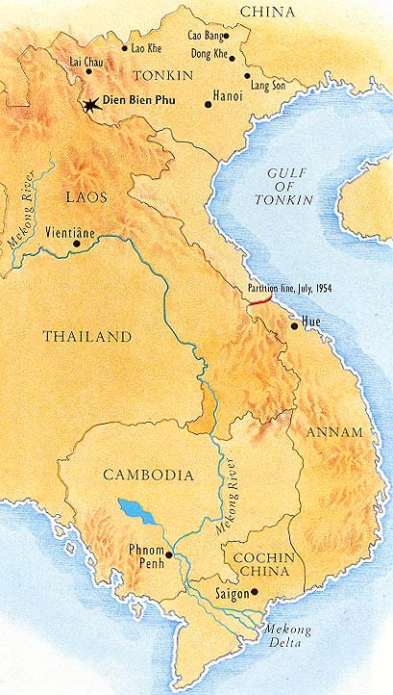
Battle at Dien Bien Phu
The French return—US (Truman) supports them
Belief in “domino theory”– if one SE Asian falls to communism , they all fall
Fail to retake Vietnam, forced to surrender

Slide 5
The Geneva Accords
In 1954, France, Britain, USSR, US, China, Laos and Cambodia met with Vietminh for peace talks
Divide Vietnam on 17th parallel,
1956 would hold an election between Communist government {North} or Nationalist (anti-communist) government {South}

Slide 6
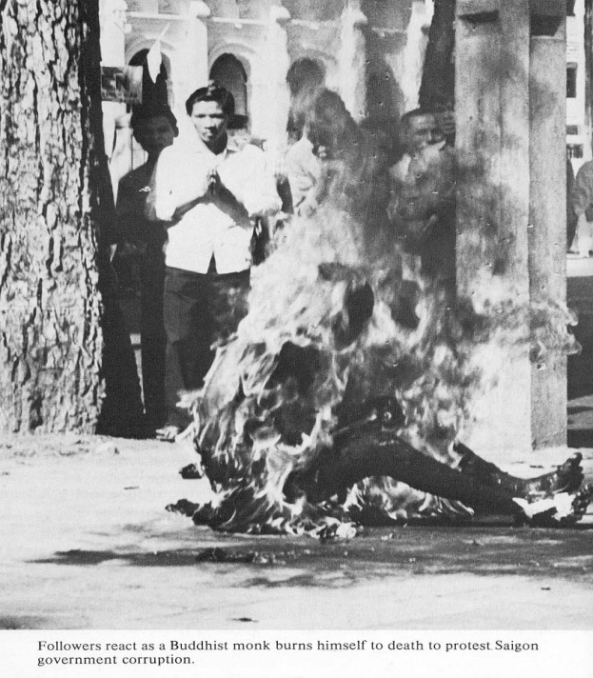
Ngo Diem
President in the South
Catholic
Corrupt and persecuted Buddhists
Even so, the U.S. supported him, since he was anti-communist

Slide 7
Ngo Diem
Ho Chi Minh gains popularity in the North and South
Diem afraid to lose ‘56 elections.
South refuses to participate.

Slide 8
Vietcong
Communist group formed in the South
Difficult to tell apart
did not wear uniforms
used guerilla tactics
South becomes unstable

Slide 9
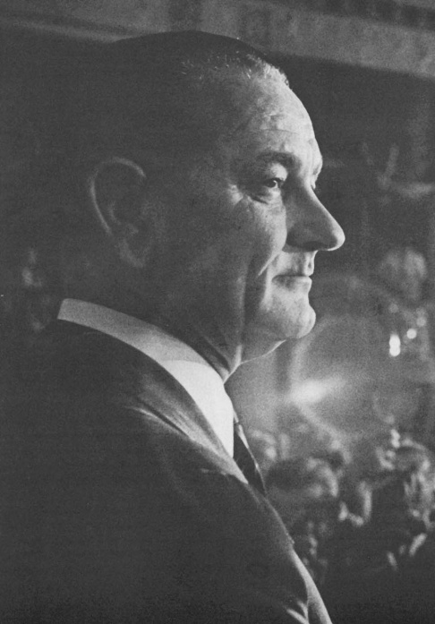
Tonkin Gulf Incident/Resolution
‘63—US supports a coup against Diem (assassinated)
Weeks later, JFK is killed & LBJ inherits the war.
LBJ wants to look “tough” on communism

Slide 10
Tonkin Gulf Incident/ Resolution
Aug ‘64, announces North Vietnam attacked one ship in the Gulf of Tonkin.
Resolution passed, giving LBJ right to take “all necessary action” to in Vietnam.
never declared war
Used as a “blank check”
Later, doubt was cast upon the events at the Gulf of Tonkin, and some believe the attack was fabricated or exaggerated to justify our involvement.

Slide 11
US Leaders
Name
Role
LBJ
McNamara
Rusk
Westmoreland
Escalates US involvement, unleashes “Op Rolling Thunder” (bombing of NV), sends over 300,000 troops
Sec of Defense
Sec of State
General of US troops

