Slide 1
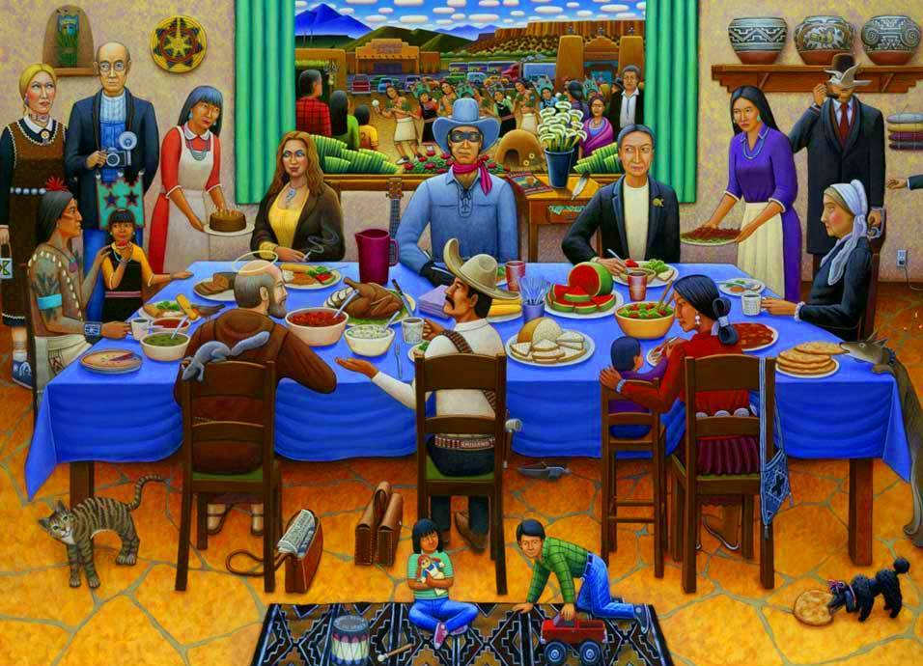
Pueblo Feast Day, David Bradley

Slide 2
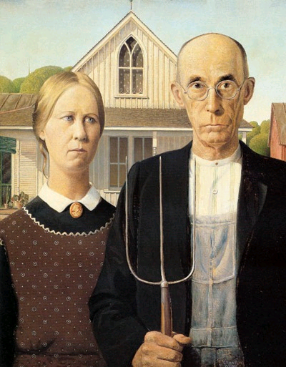
American Gothic,
Grant Wood

Slide 3
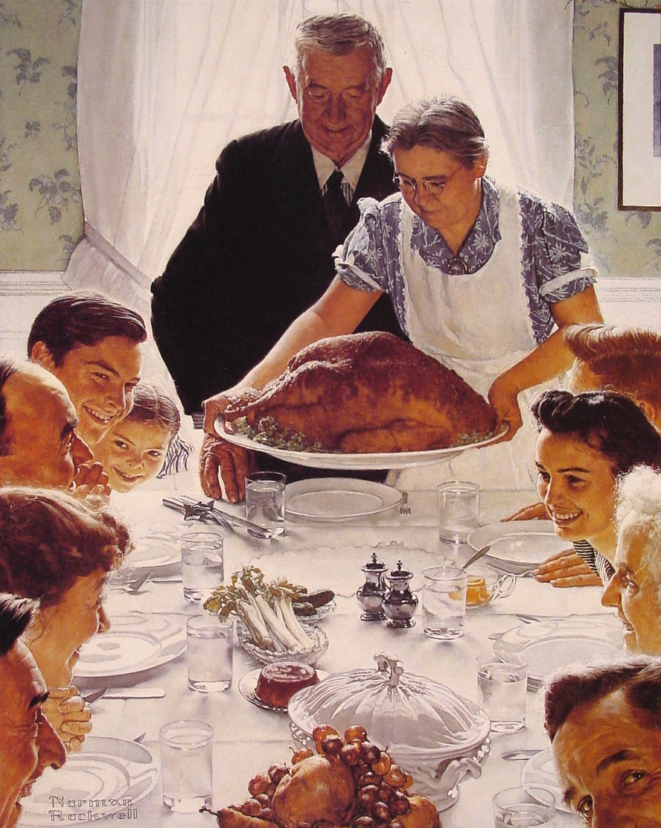
Freedom from Want,
Norman Rockwell

Slide 4
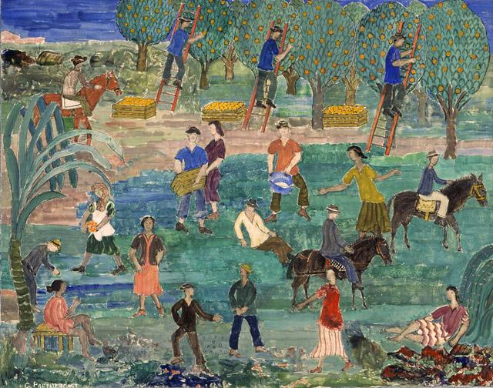
Orange Pickers, Florida, Charles James Prendergast

Slide 5
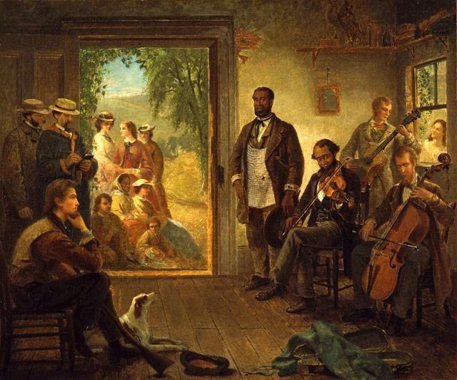
The Musicale, Barber Shop, Trenton Falls New York, Thomas Hicks

Slide 6
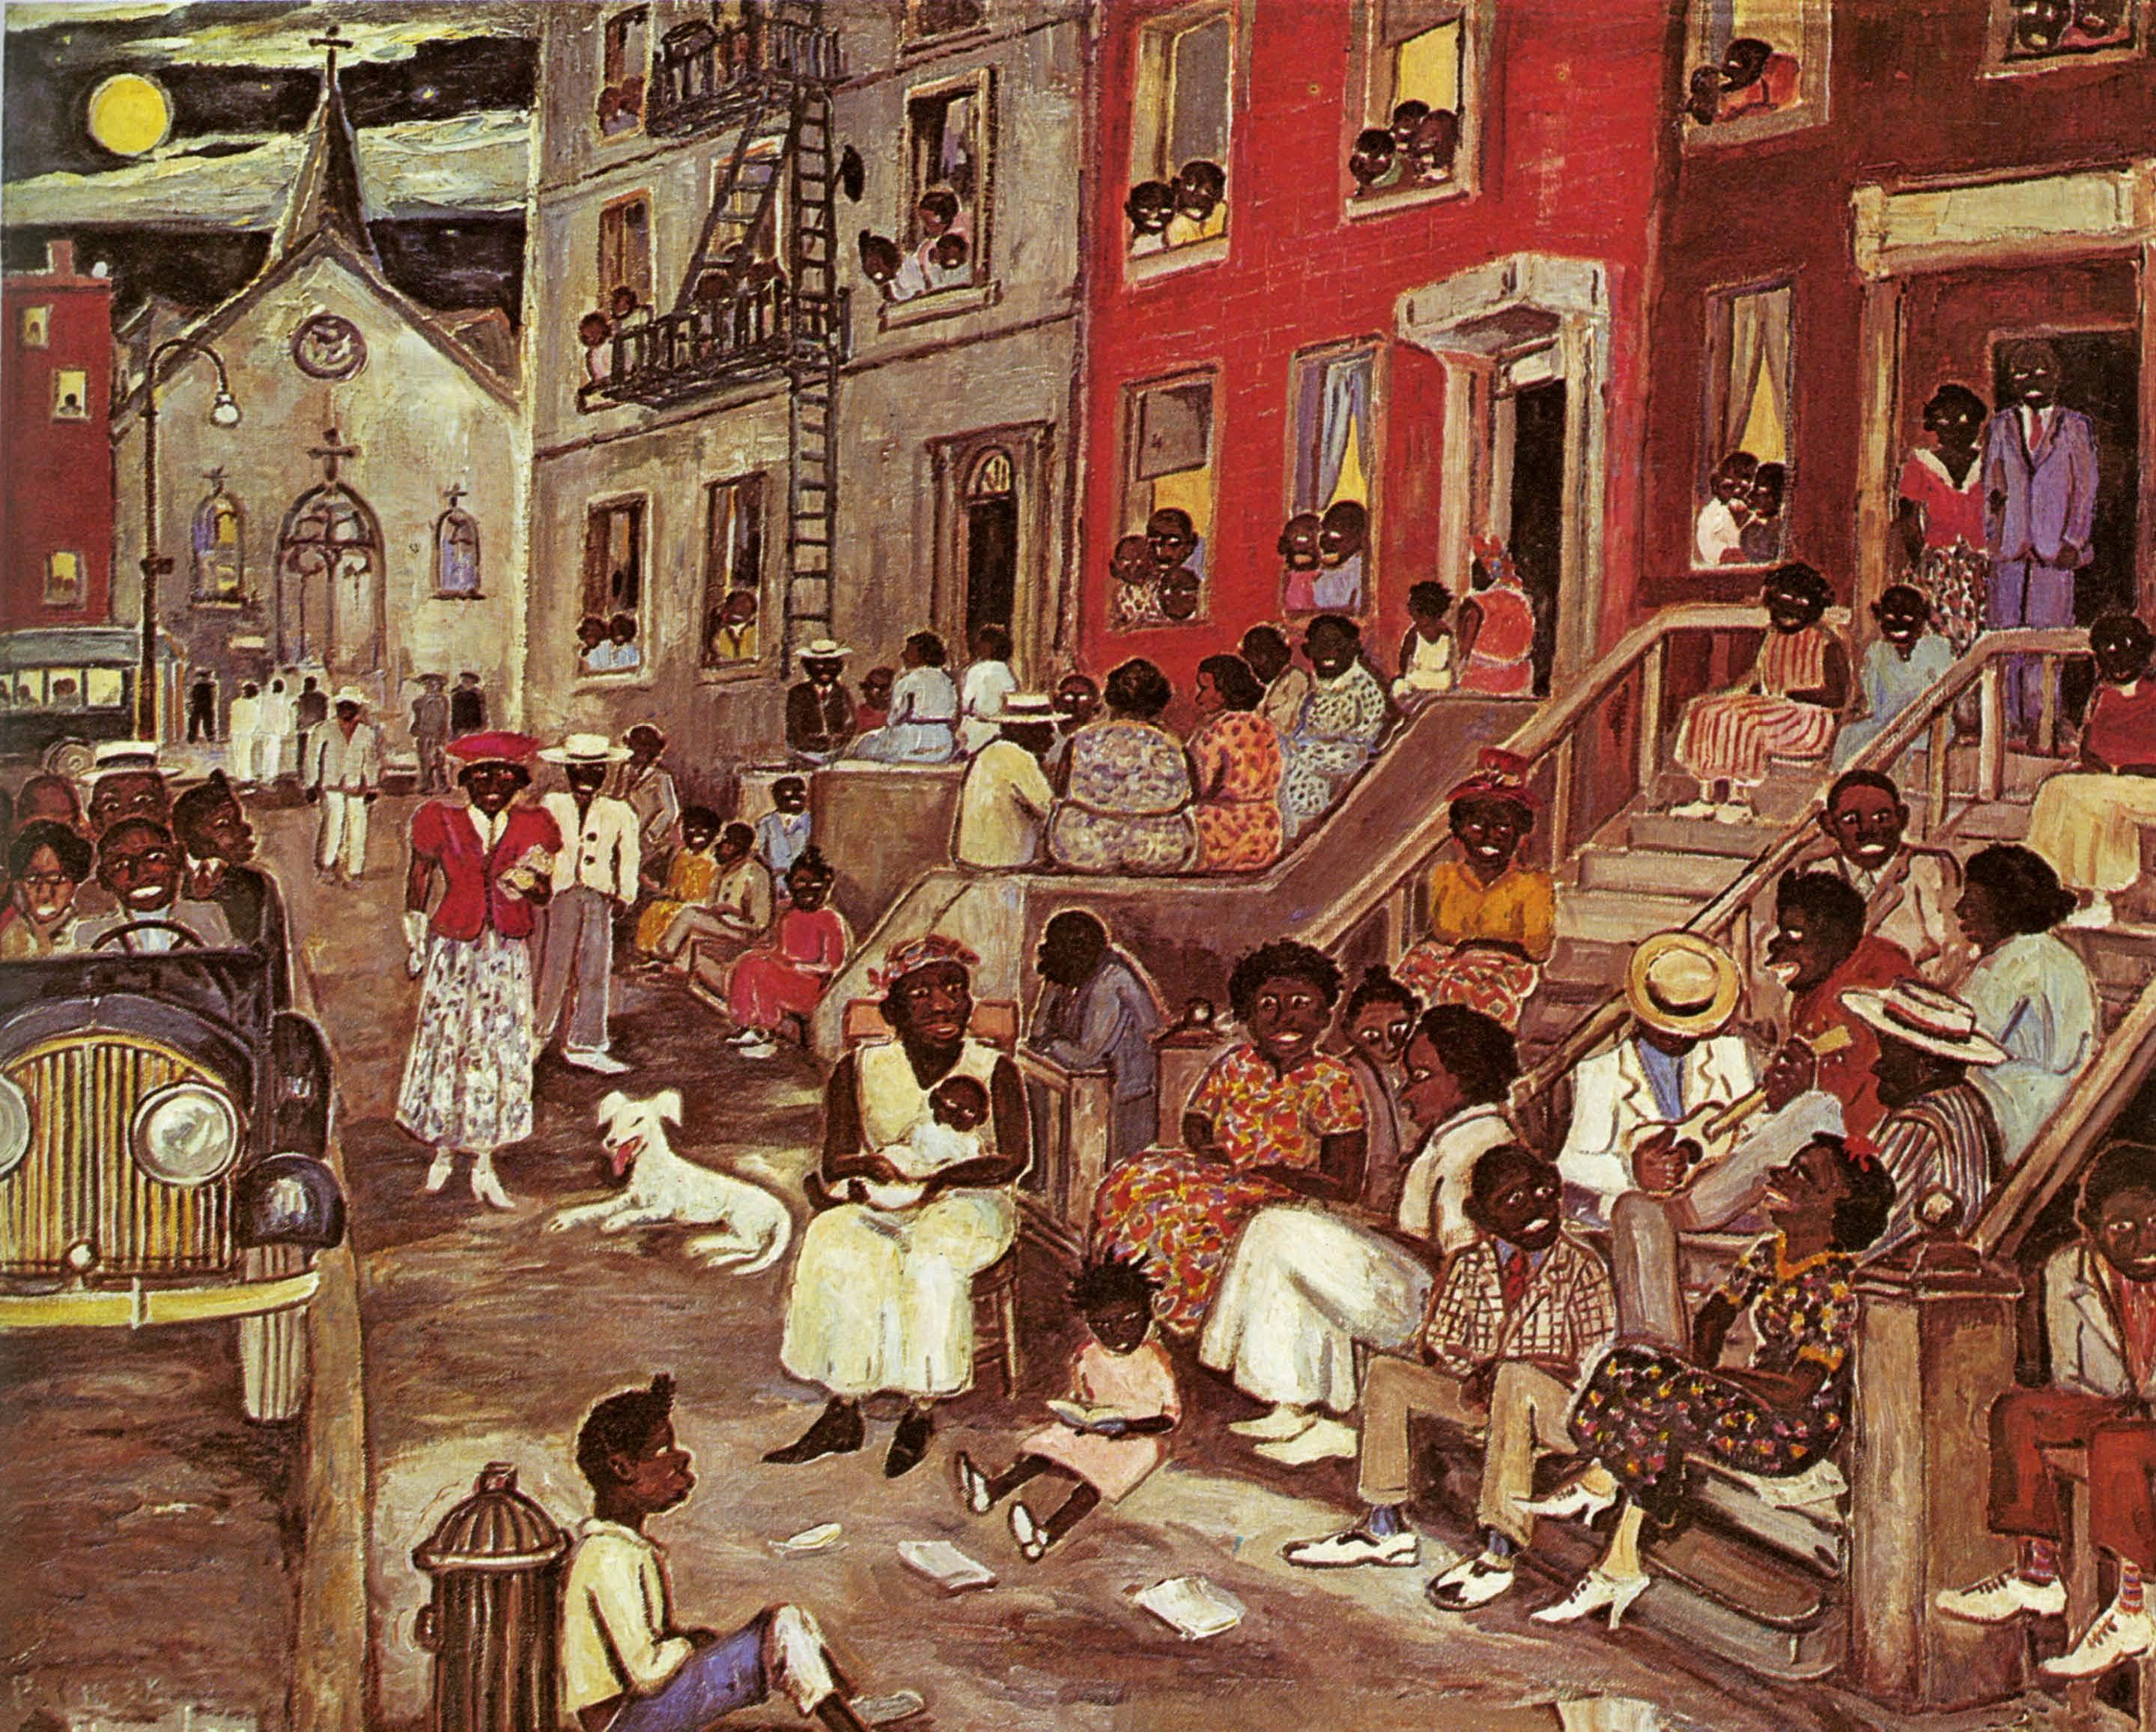
Midsummer Night in Harlem, Palmer Hayden

Slide 7
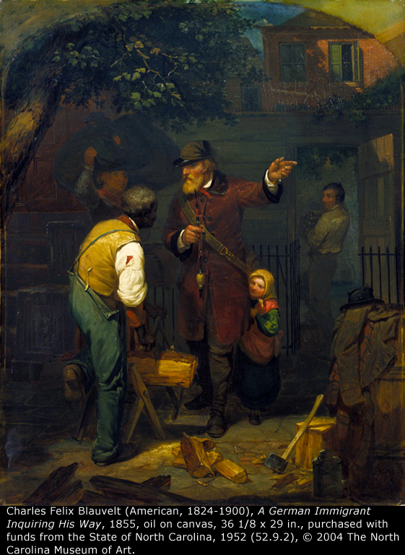
A German Immigrant Inquiring His Way, Charles Felix Blauvelt

Slide 8
Write a paragraph and draw your own picture on what you think an American is.

